Slide 1
IPL Match Winner Prediction
By Divya Prasath R S

Slide 2
Agenda
Introduction
Objectives
Data Understanding
Data Cleaning
EDA
Data Preprocessing
Model Process
Model Comparison
Conclusion

Slide 3
INTRODUCTION
This project uses machine learning to analyze historical IPL match data.
The goal is to identify trends and predict the winning team based on pre-match factors for one of the world's most competitive T20 cricket leagues.
Data reveals a steady increase in consumer demand for sustainable products, presenting an opportunity for our eco-friendly offerings.
Using machine learning techniques, it aims to predict the winning team based on pre-match factors.

Slide 4
Objectives
Predict the outcome of IPL matches using historical game date
Implement and evaluate various ML models including Logistic Regression, SVM, KNN, Decision Tree,RandomForest,XGBoost,AdaBoost.

Slide 5

DATA UNDERSTANDING
The dataset used in this project is the IPL Matches Dataset, which contains information about Indian Premier League (IPL) cricket matches.
Each row represents a single match, and the columns capture details about the match, such as the season, venue, participating teams, toss decision, match outcome, and performance highlights.
The dataset consists of 756 rows (matches) and 18 columns .

Slide 6
DATA CLEANING
Removed irrelevant columns (id, Date, umpires).
Handled missing values.
Encoded categorical columns into numeric using one-hot encoding.
Scaled numerical values for better model performance.
Ensured no duplicates and preserved class balance.

Slide 7
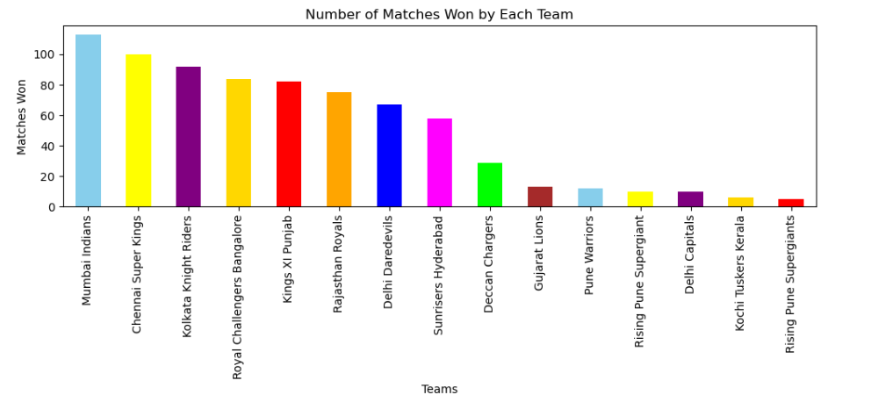
EDA
Match Distribution by Season
Chart: Bar chart showing the number of matches played each season.
Insight: Helps identify growth of IPL across seasons.

Slide 8
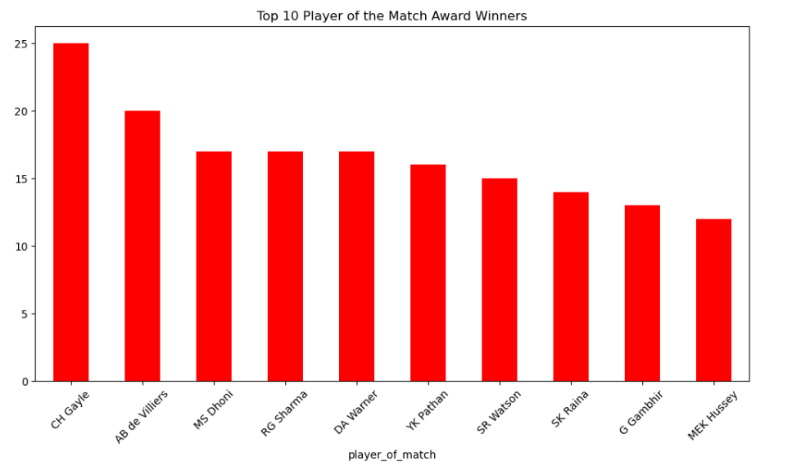
EDA
Player of the Match Awards
Chart: Bar chart of top players with the most “Player of the Match” awards.
Insight: Identifies consistent match-winners in IPL history.

Slide 9
Model PROCESS
Models Used
We applied a variety of supervised machine learning classification algorithms to predict match outcomes:
Logistic Regression
Support Vector Machine (SVM)
K-Nearest Neighbors (KNN)
Decision Tree Classifier
Random Forest Classifier
AdaBoost Classifier
Gradient Boosting Classifier
XGBoost Classifier

Slide 10
Model PROCESS
Hyperparameter Tuning
To optimize model performance, we used GridSearchCV with cross-validation.
For each algorithm, a range of key hyperparameters was tested:
Logistic Regression: Regularization strength (C), solver type.
SVM: Kernel type, C, and gamma.
KNN: Number of neighbors, distance metrics.
Decision Tree: Maximum depth, splitting criterion.
Random Forest: Number of trees (n_estimators), depth, split criteria.
Boosting Models (AdaBoost, Gradient Boosting, XGBoost): Learning rate, number of estimators, maximum depth.
The best estimator from each tuning process was selected for evaluation.

Slide 11
Model PROCESS
Evaluation Metrics
To assess the models comprehensively, we used multiple performance metrics:
Accuracy – Overall proportion of correct predictions.
Precision – Ability of the model to avoid false positives.
Recall – Ability of the model to correctly identify true positives.
F1-Score – Harmonic mean of Precision and Recall.
Confusion Matrix – To visualize correct vs incorrect predictions.

Slide 12
Model PROCESS
Best-Performing Model
The XGBoost Classifier achieved the highest Accuracy (0.97) and F1 Score (0.96) among all models.
It balances both bias and variance effectively due to gradient boosting and ensemble learning.
Other models like Gradient Boosting and Random Forest also performed well, but XGBoost slightly outperformed them.

Slide 13
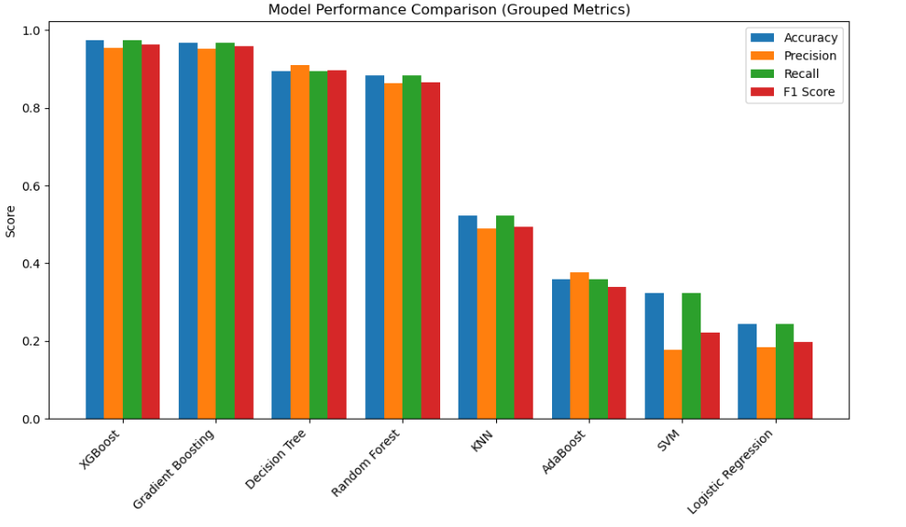
Model Comparison

Slide 14
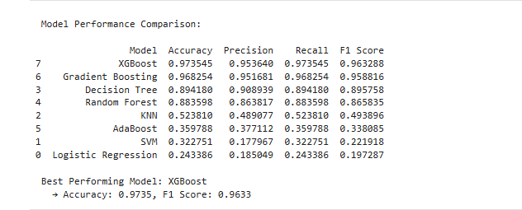
Model Comparison

Slide 15
Conclusion
How the Model Can Be Improved
Feature Engineering:
Include more context features (e.g., weather, pitch conditions, player statistics) to improve prediction accuracy.
Data Balancing:
Handle class imbalance (some teams win more often) using resampling techniques (SMOTE/undersampling).
Advanced Models:
Try deep learning architectures (Neural Networks, LSTMs for sequential match data).
Ensemble Techniques:
Combine multiple models (stacking, voting) for better generalization.
Hyperparameter Optimization:

Slide 16

THANK YOU

